Slide 1
Precipitation
Formation & Types

Slide 2
Cloud Droplets & Precipitation
What factor determines whether or not a cloud will produce rain?
Water Droplet Size
Clouds will precipitate once the droplets grow to a sufficient size.
Cloud droplets are typically on the order of 20µm (0.02mm), while a typical Raindrop is 100 times larger (2000µm (2mm))
Cloud droplets are small due to the abundance condensation nuclei,
Available water vapor is spread over many nuclei

Slide 3
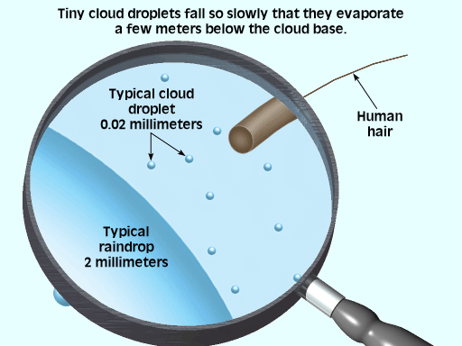
Raindrop Size is 100x that of a cloud droplet
Raindrop Volume is a million times greater than that of a cloud droplet (100 x 100 x 100)

Slide 4
Cloud Droplets & Precipitation
Why is Droplet Size Important?
All objects, including cloud droplets, are subject to the laws of gravity.
As such, we would expect these droplets to fall to Earth.
However, as they fall through the atmosphere the encounter resistance from the air known as ‘Drag’.

Slide 5
Cloud Droplets & Precipitation
Why is Droplet Size Important? (Cont.)
Terminal Velocity
Maximum Speed at which an object will fall.
Occurs when the forces of drag equal that of gravity , BIGGER DROPS FALLS FASTER.
The Terminal Velocity of Cloud Droplets is so slow that they will evaporate long before they ever reach the ground
This is not true of Raindrops; they reach the ground prior to evaporating away.

Slide 6
Precipitation Formation
Formation of Raindrops from cloud droplets:
NOT a simple case of continued condensation.
Cloud must be supersaturated for cloud droplets to grow beyond critical point.
There is only a limited amount of water vapor available for condensation that has to be shared among cloud drops.
Number of cloud drops governed by number of cloud nuclei. More drops mean smaller drops and less drops mean bigger drops since total mass of drops limited by available water vapor.

Slide 7
Precipitation Formation
2 Processes Responsible For Overcoming These Limitations:
Bergeron Process
Collision-Coalescence Process

Slide 8
Precipitation Formation
Bergeron Process
Term – Supercooled Water
While water at the earth’s surface will freeze at 0 °C (32 °F), this is NOT the case with suspended water in the Atmosphere
Ice crystals are difficult to form because of their complex shape, need special nuclei
Thus, water remains in its liquid state below 0 °C (32 °F) and is termed Supercooled.

Slide 9
Precipitation Formation
Bergeron Process (Cont.)
Concept – Clouds are not always composed of Water Droplets: sometimes they’re composed of Ice Crystals
Dependant upon Cloud Temperature
Water Droplets Only (> -10 °C)
Water Droplets & Ice Crystals (-10 °C to -20 °C)
Ice Crystals Only (< -20 °C)
This can be observed in a single cloud…

Slide 10
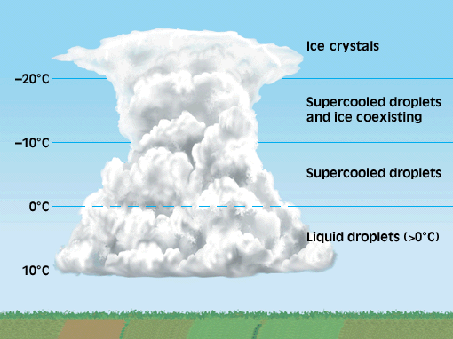

Slide 11
Precipitation Formation
Bergeron Process (Cont.)
Concept – Saturation Vapor Pressure of Ice Crystals is LOWER than that around supercooled water.
i.e. Less water vapor is required to achieve saturation for Ice Crystals than droplets
Thus, when air is saturated (RH = 100%) with respect to water droplets,
it is supersaturated with respect to ice crystals

Slide 12
Precipitation Formation
Bergeron Process (Cont.)
Temperature °C | Relative Humidity with Respect to:
 | Water | Ice
0 | 100% | 100%
-5 | 100% | 105%
-10 | 100% | 110%
-15 | 100% | 115%
-20 | 100% | 121%

Slide 13
Super Saturation: Deposition > Sublimation
Saturation: Evaporation = Condensation

Slide 14
Thus, while the water droplets are in equilibrium, the Ice Crystals continue to grow as water vapor is deposited on their surfaces.
Meanwhile, there is now less vapor available for condensation. Thus, the supercooled water droplets undergo net evaporation until the equilibrium is restored

Slide 15
The net evaporation of the droplets means that there is more vapor available for deposition, so the Ice Crystals grow further.
This cycle continues until the Ice Crystals are large enough to fall to the Earth’s surface.
This is the BERGERON PROCESS : Ice Crystals growing at the expense of Supercooled Water Droplets
It can only occur in clouds where temperatures support both Supercooled Droplets and Ice Crystals

Slide 16
Precipitation Formation
Collision-Coalescence Process
Mechanism that causes the development of Raindrops when Water Droplets & Ice Crystals do NOT co-exist
Some droplets will be naturally larger than others
(i.e. Curvature, Solutes)
This has the effect that they have greater Terminal Velocities than smaller droplets

Slide 17
Precipitation Formation
Collision-Coalescence Process
Thus, large droplets will fall faster than small droplets
These droplets will crash, randomly, into the smaller objects and coalesce
This causes the droplets to grow until they are large enough to fall to the Earth’s surface
Raindrops can grow as large as 5mm. Beyond this size they break-up and form new collector drops.

Slide 18
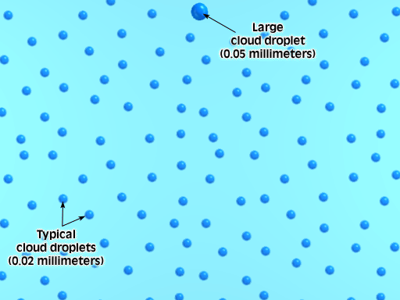
Updrafts lift the smaller droplets into the collector drops

Slide 19
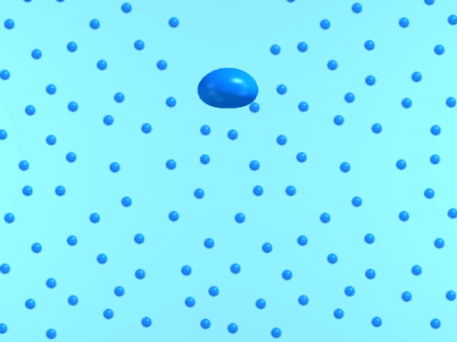
Updrafts lift the smaller droplets into the collector drops
This is particularly true of tall (cumulonimbus) clouds

Slide 20
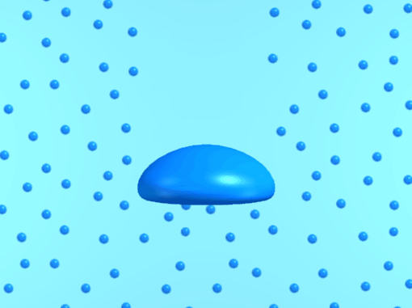
Drag causes the raindrop to flatten out
This makes it more efficient at catching other droplets

Slide 21
Precipitation Formation
Riming (Accretion)
When Ice Crystals fall through a cloud and collide with supercooled droplets, the liquid water freezes onto the Ice Crystal.
This leads to rapid growth of the Ice Crystal, which…
Leads to greater Terminal Velocities and further potential for Riming (Accretion)

Slide 25
Known as Graupel
Can form the nucleus of ‘True’ Hailstones or fall to Earth as ‘Soft Hail’

Slide 26
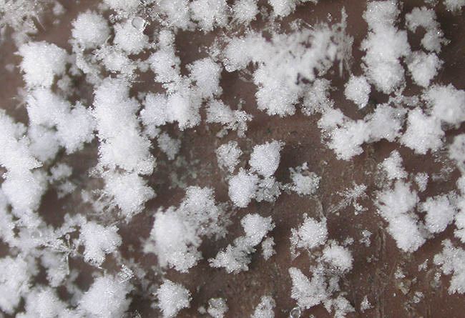

Slide 27
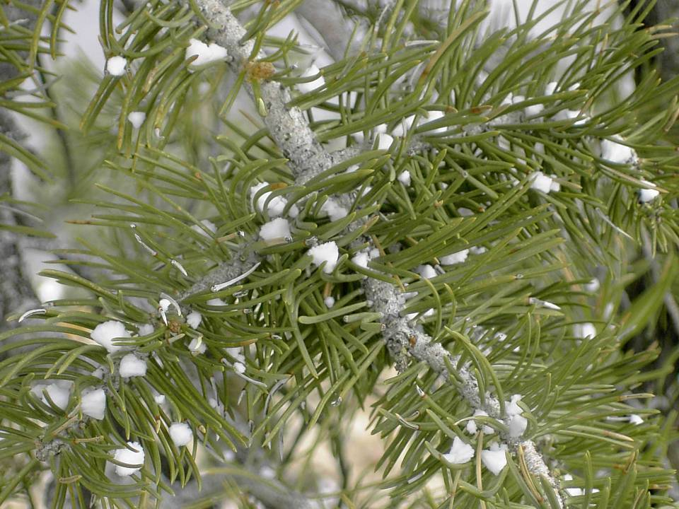

Slide 28
Precipitation Formation
Aggregation
The joining of two Ice Crystals into a single, larger one.
Occurs most readily when the crystals have a thin coating of water, as this makes them more ‘adhesive’
Thus, the largest snow flakes are encountered when clouds are just slightly below 0 °C

Slide 30
Precipitation Formation
Cloud Temperature
Dependant upon Altitude & Latitude
Tropics
Predominantly Collision-Coalescence Process
Bergeron Process may be seen in Tall Cumulonimbus Clouds
Mid-Latitudes
Clouds are predominantly composed of Ice Crystals
Thus precipitation forms through the Bergeron & Collision-Coalescence Processes
Precipitation Types
Manner in which precip. reaches the ground is dependant upon the temperatures encountered upon leaving the cloud

Slide 31
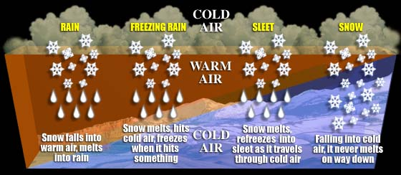

Slide 32
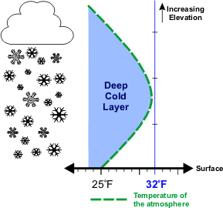
Precipitation Forms
Snow
Deposition, Accretion & Aggregation
Snow will arrive at the ground providing it does not melt during its descent.
Thus the varying temperature of the environmental air must not exceed the freezing point.

Slide 33
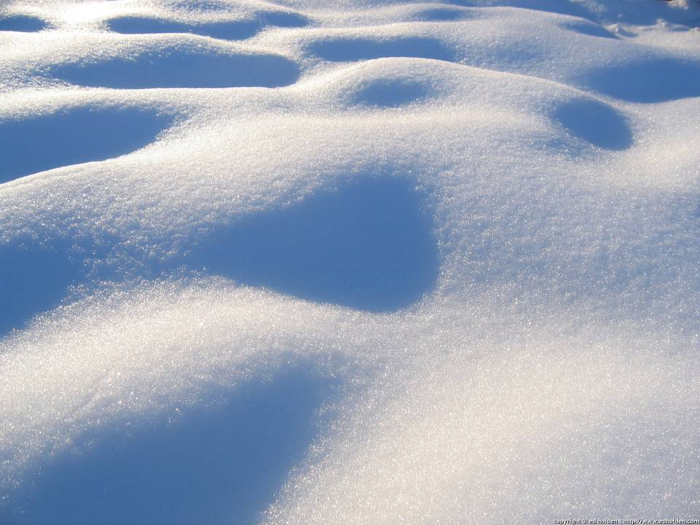

Slide 34
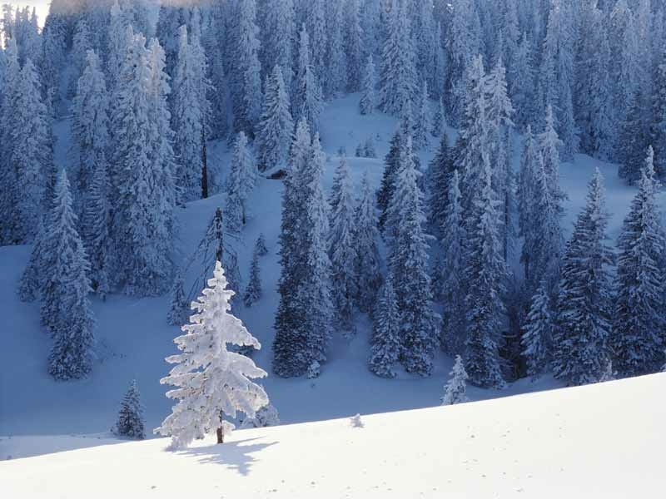

Slide 35
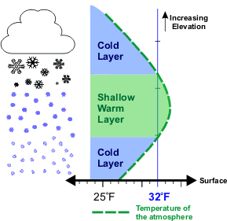
Precipitation Forms
Sleet
Ice Crystals pass through a shallow warm zone
Atmospheric Inversion – as is seen with the advance of a warm front
Crystals partially melt, then freeze again prior to arriving at the surface
Clear/Translucent Ice Pellets

Slide 36
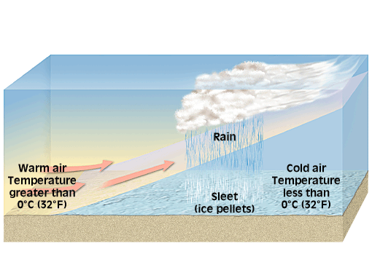

Slide 37
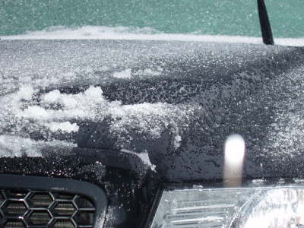

Slide 38
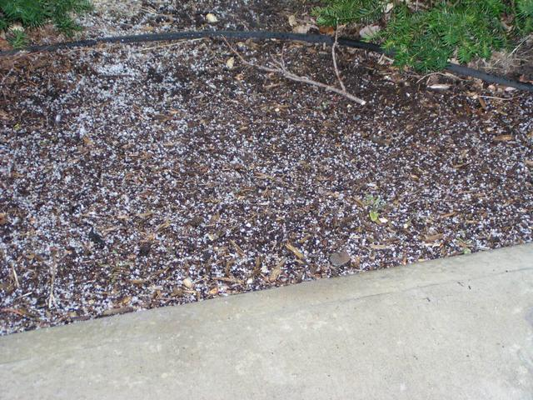

Slide 39
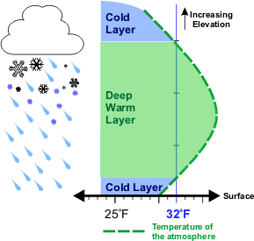
Precipitation Forms
Freezing Rain/Glaze
Ice Crystals pass through a deeper warm zone
Increased advancement of a warm front
Crystals melt, but DO NOT freeze again before arriving at the surface
Instead, the raindrops are supercooled
Drops need surface to freeze onto

Slide 40
Precipitation Forms
Freezing Rain (Cont.)
Upon impact, the rain momentarily forms a thin coating upon the surface.
This coating then freezes
This Glazed Coating of Ice can become heavy enough to down power lines and trees
Can also form dangerous coatings of Ice on roads.

Slide 41
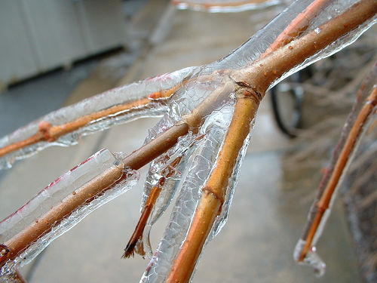

Slide 42
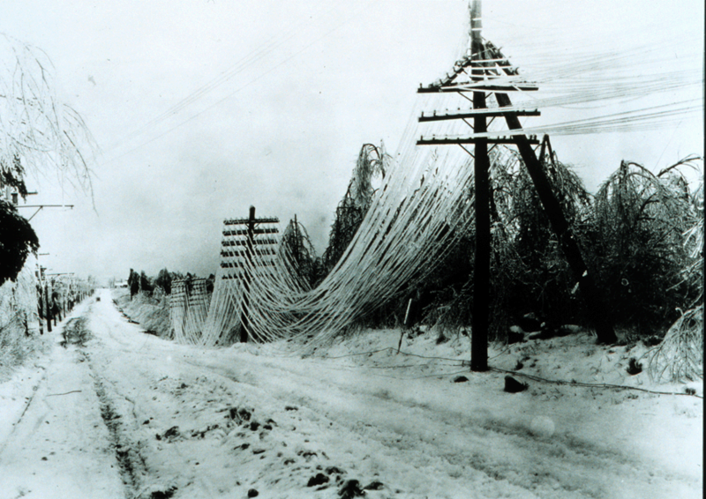

Slide 43
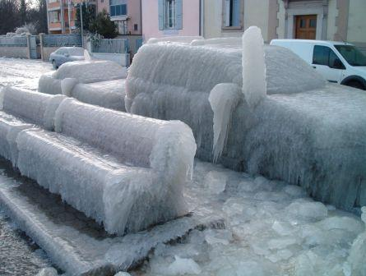

Slide 44
Precipitation Forms
Hail
Precipitation in the form of hard, rounded pellets or irregular lumps of ice
Large hailstones can be very destructive! Especially to agriculture.
Ice Crystals grow through Riming (Accretion)
Known as Graupel. Eventually become Hailstones

Slide 45
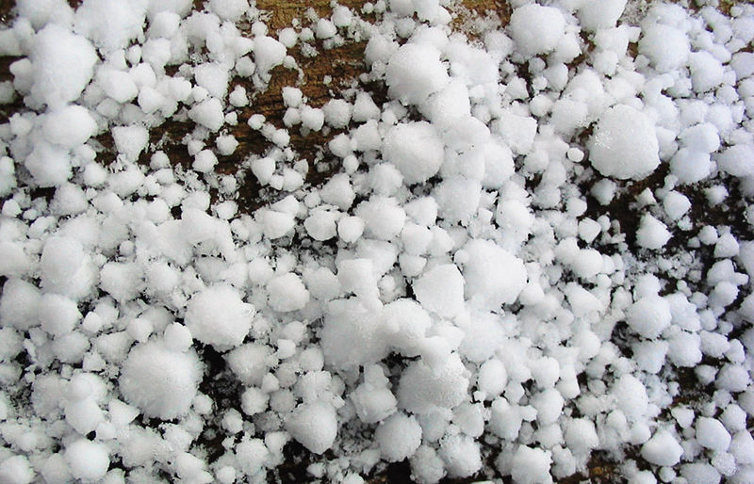

Slide 46
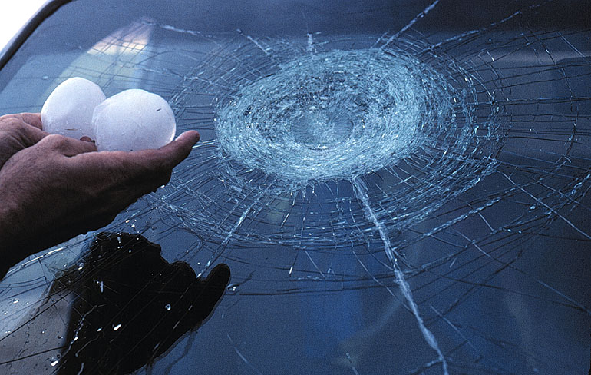

Slide 47
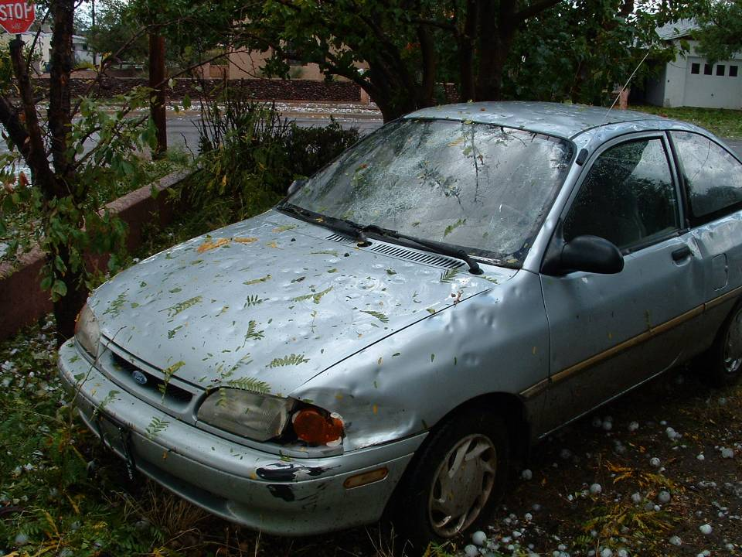

Slide 48
Precipitation Forms
Hail (Cont.)
These Hailstones cycle up and down through the cloud as they are carried aloft by a series of updrafts
Eventually, the hailstones encounter a downdraft or grow large enough to overcome the updrafts

Slide 49
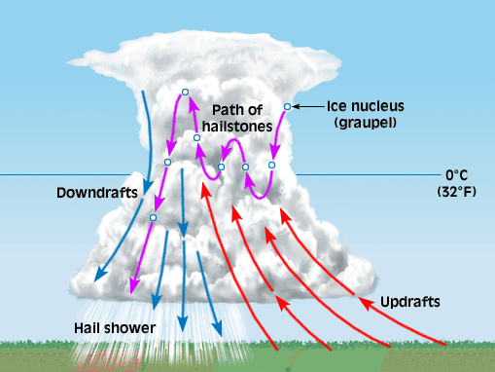

Slide 50
Precipitation Forms
Virga
Raindrops that evaporate before reaching the ground
Appear as streaks of precipitation falling from a cloud that extend only part way to the surface.

Slide 51
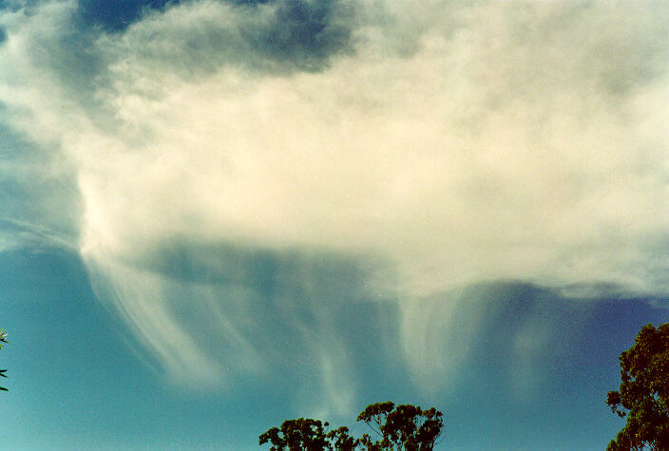

Slide 52
